Slide 1
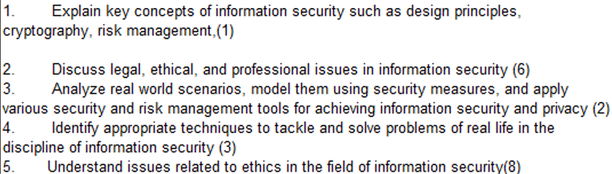
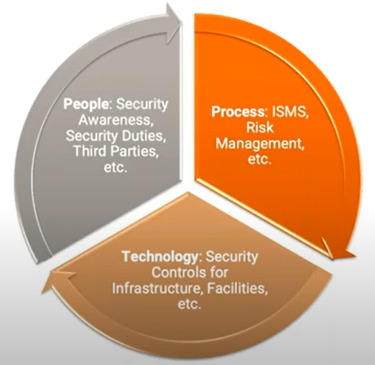
CS 3002 Information Security
Fall 2023
Week # 5 – Lecture # 13, 14, 15
Dr. Aqsa Aslam

Slide 2
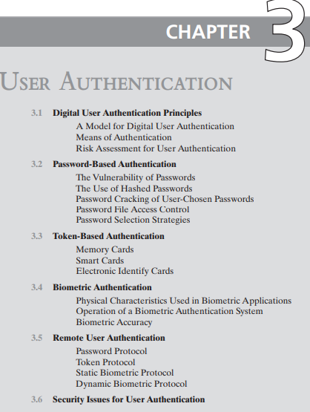
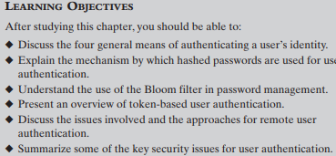

Slide 3
User Authentication
User authentication is a fundamental security building block
User authentication is the basis for:
Access control and User accountability
User authentication encompasses two functions
Identification:
The user identifies herself to the system by presenting a credential
such as user ID.
Verification:
The system verifies the user by the exchange of authentication information.
User Authentication is distinct from message authentication
(when communicating parties are concerned with the integrity of the exchanges messages)
Identification → means by which a user provides a claimed identity to the system
User authentication → means of establishing the validity of the claim

Slide 4
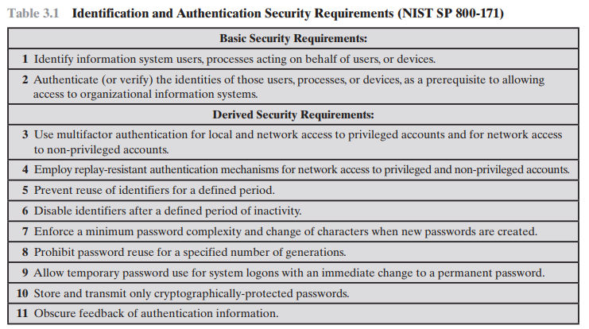

Slide 5
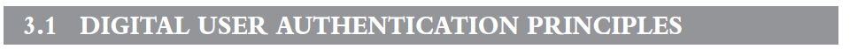
NIST SP 800-63-3 (Digital Authentication Guideline, October 2016) defines digital user authentication as the process of establishing confidence in user identities that are presented electronically to an information system.
Systems can use the authenticated identity to determine if the authenticated individual is authorized to perform particular function such as database transactions or access to system resources.

Slide 6
A Model for Digital User Authentication
The NIST SP 800-63-2 model
The initial requirement for performing user authentication is that the user must be registered with the system.
An applicant applies to a registration authority (RA) to become a subscriber of a credential service provider (CSP).
RA is a trusted entity that establishes and vouches for the identity of an applicant to a CSP.
The CSP then engages in an exchange with the subscriber. The CSP issues some sort of electronic credential to the subscriber. The credential (a data structure) binds an identity to a token possessed by the subscriber
The party to be authenticated is called a claimant
The party verifying that identity is called a verifier
The verifier passes on an assertion about the identity of the subscriber to the relying party (RP).
The RP can use the authenticated information provided by the verifier to make access control or authorization decisions.

Slide 7
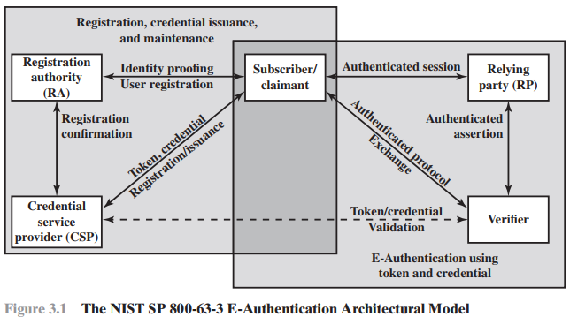

Slide 8
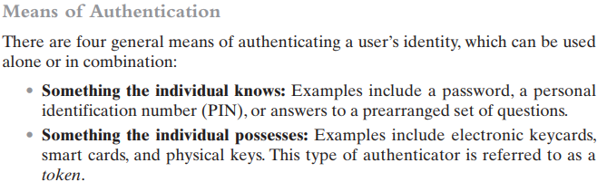

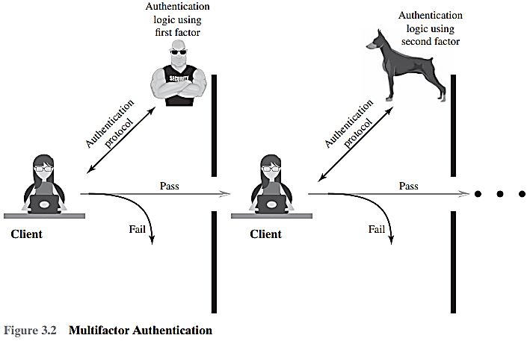
Multifactor authentication refers to the use of more than one of the authentication means in the preceding list. Implementations that use two factors are considered to be stronger than those that use only one factor; systems that incorporate three factors are stronger than systems that only incorporate two of the factors, and so on.

Slide 9
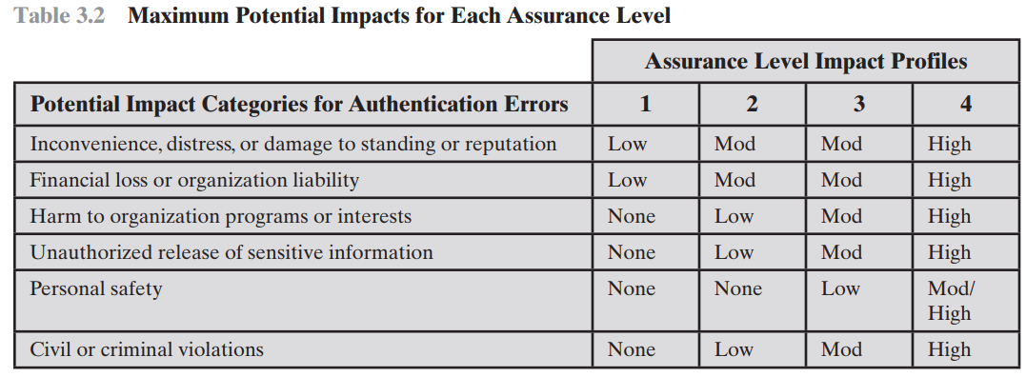
This table suggests a technique for doing risk assessment. For a given information system or service asset of an organization, the organization needs to determine the level of impact if an authentication failure occurs, using the categories of impact, or risk areas, that are of concern.
Read Assurance levels, Potential risk, Risk from the book

Slide 10
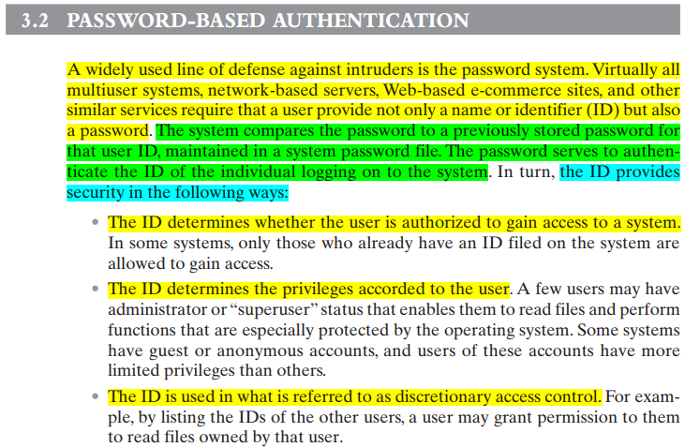

Slide 11
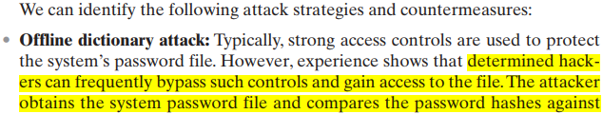
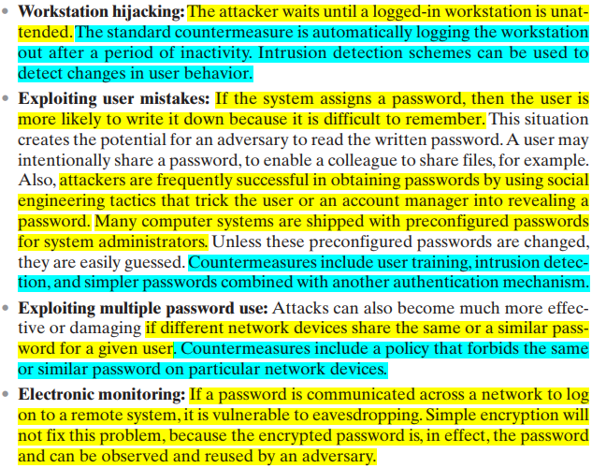
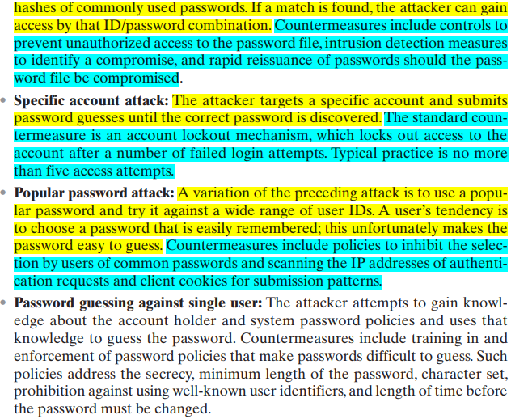

Slide 12
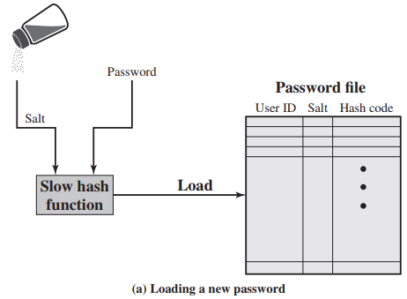
A widely used password security technique
use of hashed passwords and a salt value
This scheme is found on virtually all UNIX operating system
To load a new password into the system, the user selects or is assigned a password. (see Figure 3.3a).
This password is combined with a fixed-length salt value
use a pseudorandom or random number.
can be anything like time, date etc.
The hash algorithm is designed to be slow to execute in order to thwart attacks
The hashed password is then stored, together with a plaintext copy of the salt, in the password file for the corresponding user ID.
The hashed password method has been shown to be secure against a variety of cryptanalytic attacks

Slide 13
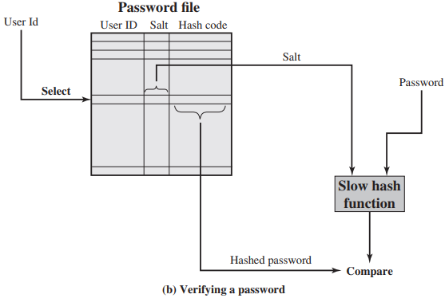
When a user attempts to log on to a UNIX system, the user provides:
an ID and a password (see Figure 3.3b).
The operating system uses:
the ID to index into the password file and retrieve the plaintext salt and the encrypted password.
The salt and user-supplied password are used as input to the encryption routine.
If the result matches the stored value, the password is accepted.

Slide 14
Why a salt value?
The salt serves three purposes:
It prevents duplicate passwords from being visible in the password file.
Even if two users choose the same password, those passwords will be assigned different salt values.
Hence, the hashed passwords of the two users will differ.
It greatly increases the difficulty of offline dictionary attacks.
For a salt of length b bits, the number of possible passwords is increased by a factor of 2b,
Increasing the difficulty of guessing a password in a dictionary attack.
Nearly impossible to tell if a person used the same password on multiple systems

Slide 15
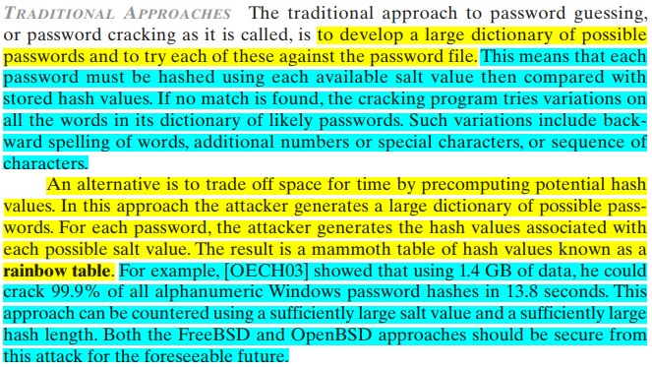

Slide 16
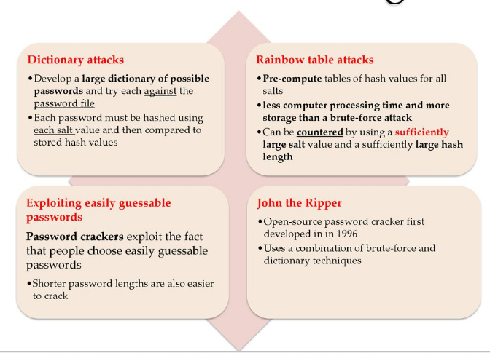
Password Cracking
Notes:
The traditional approach to password guessing, or password cracking as it is called, is to develop a large dictionary of possible passwords and to try each of these against the password file. This means that each password must be hashed using each available salt value and then compared to stored hash values. If no match is found, then the cracking program tries variations on all the words in its dictionary of likely passwords. Such variations include backward spelling of words, additional numbers or special characters, or sequence of characters, An alternative is to trade off space for time by precomputing potential hash values. In this approach the attacker generates a large dictionary of possible passwords. For each password, the attacker generates the hash values associated with each possible salt value. The result is a mammoth table of hash values known as a rainbow table. For example, [OECH03] showed that using 1.4 GB of data, he could crack 99.9% of all alphanumeric Windows password hashes in 13.8 seconds. This approach can be countered by using a sufficiently large salt value and a sufficiently large hash length. Both the FreeBSD and OpenBSD approaches should be secure from this attack for the foreseeable future.

Slide 17
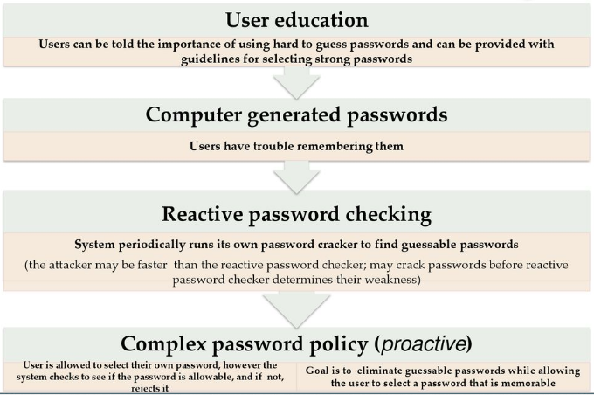
Password select strategies
Goal to eliminate guessable passwords
Still easy for user to remember
Techniques
Notes:
The lesson from the two experiments just described (Tables 3.1and 3.2) is that, when not constrained,many users choose a password that is too short or too easy to guess. At the other extreme,if users are assigned passwords consisting of eight randomly selected printable characters, password cracking is effectively impossible. But it would be almost as impossible for most users to remember their passwords. Fortunately, even if we limit the password universe to strings of characters that are reasonably memorable, the size of the universe is still too large to permit practical cracking. Our goal, then, is to eliminate guessable passwords while allowing the user to select a password that is memorable. Four basic techniques are in use:
• User education - Users can be told the importance of using hard-to-guess passwords and can be provided with guidelines for selecting strong passwords. Can be problematic when have a large user population or a lot of turnover, and because many users will simply ignore the guidelines.
• Computer-generated passwords - have a history of poor acceptance by users, if random in nature, users will not remember them, if pronounceable, the user may still be tempted to write it down.
• Reactive password checking - where the system periodically runs its own password cracker to find guessable passwords.The system cancels any passwords that are guessed and notifies the user. Can be costly in resources to implement.
• Proactive password checking - where user selects own password which the system then checks to see if it is is allowable and, if not, rejects it. It must strike a balance between user acceptability and strength. Likely the best solution.

Slide 18
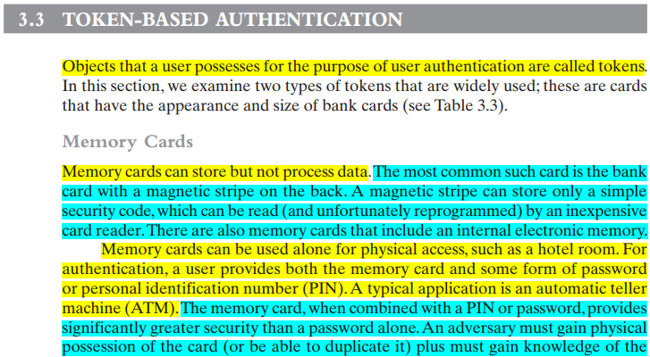
Read about potential drawbacks from the book

Slide 19
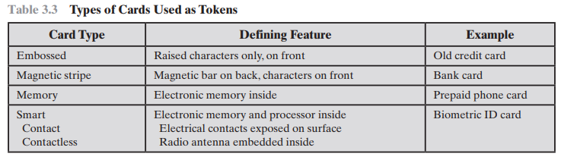

Slide 20
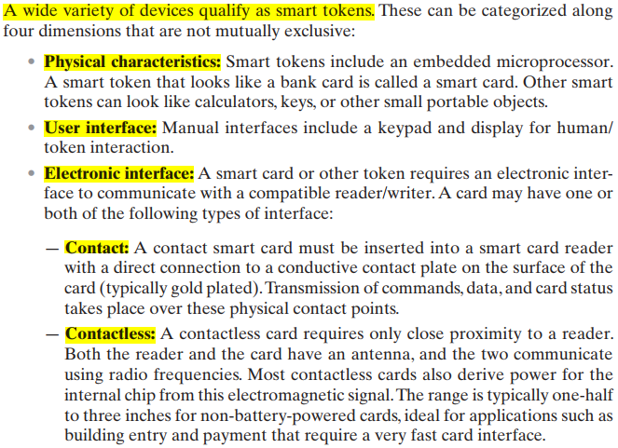
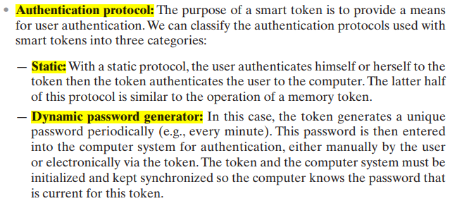


Slide 21
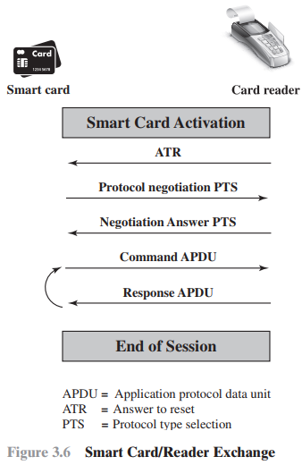
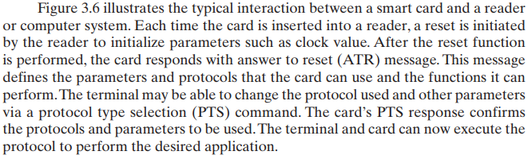

Slide 22
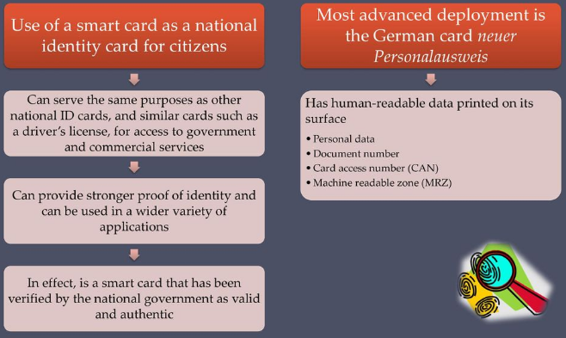
Electronic Identity Cards (eID)

Slide 23
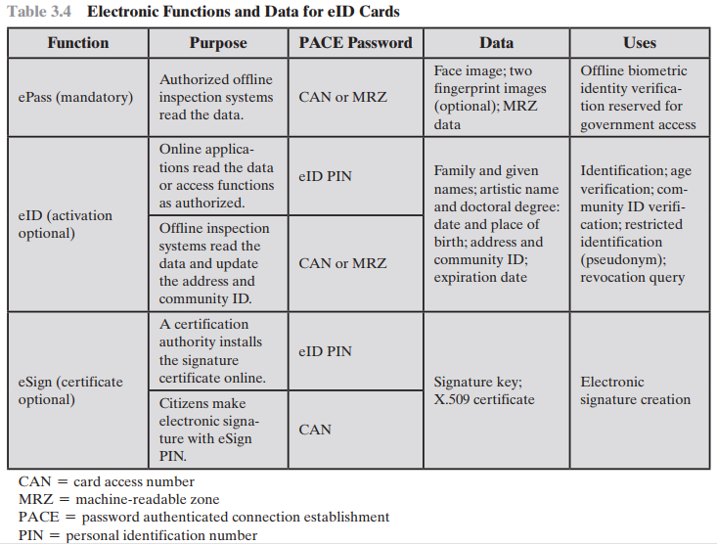
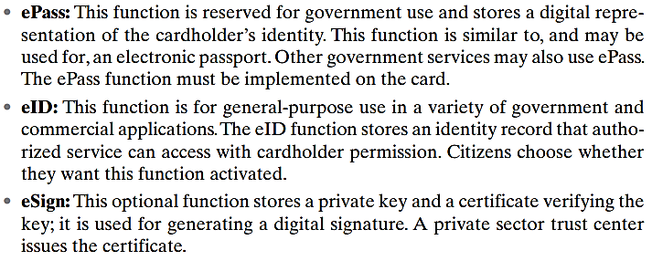
The card has the following three separate electronic functions, each with its own protected dataset (see Table 3.4):

Slide 24
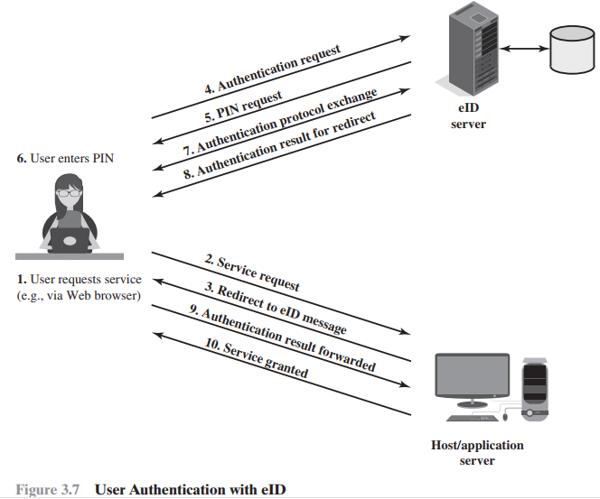
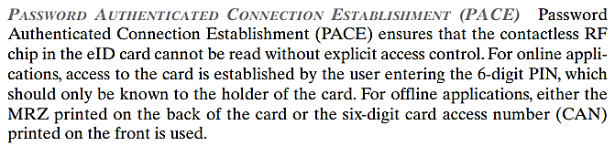

Slide 25
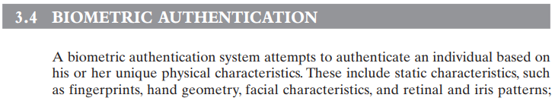
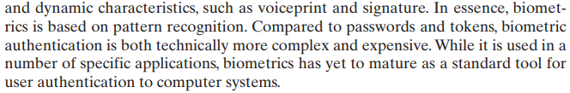

Slide 26
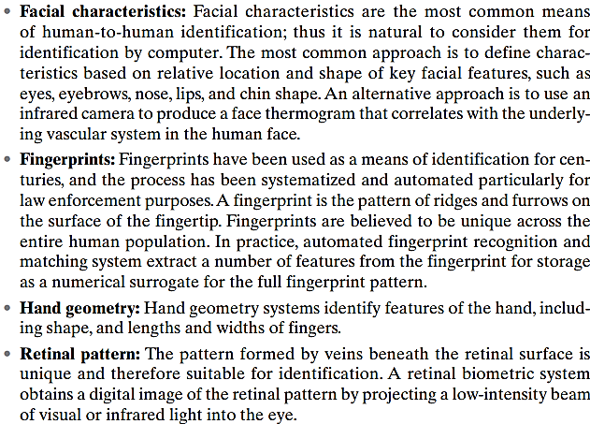
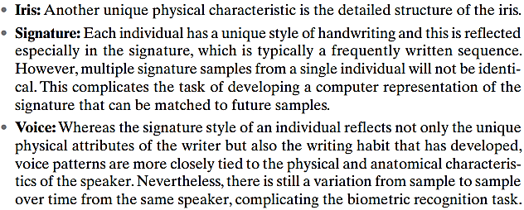
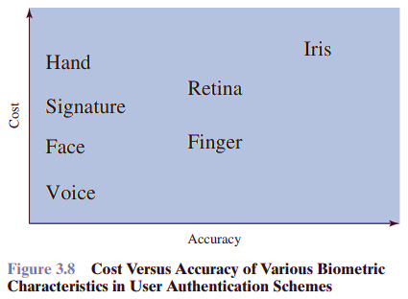

Slide 27
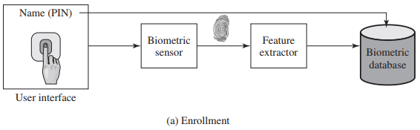
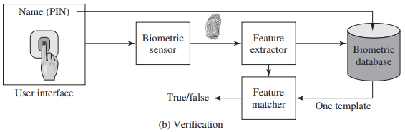

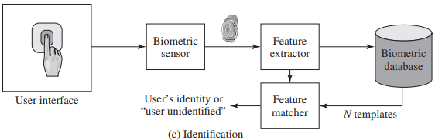

Slide 28
REMOTE USER AUTHENTICATION
Authentication over a network, the Internet, or a communications link is more complex
Additional security threats such as:
Eavesdropping, capturing a password, replaying an authentication sequence that has been observed
Generally use challenge-response
user sends identity
host responds with random number r
user computes f(r,h(P)) and sends back
host compares value from user with own computed value, if match user authenticated
The simplest form of user authentication is local authentication, in which a user attempts to access a system that is locally present, such as
a stand-alone office PC or an ATM machine.

Slide 29
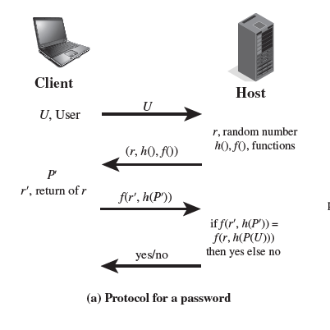
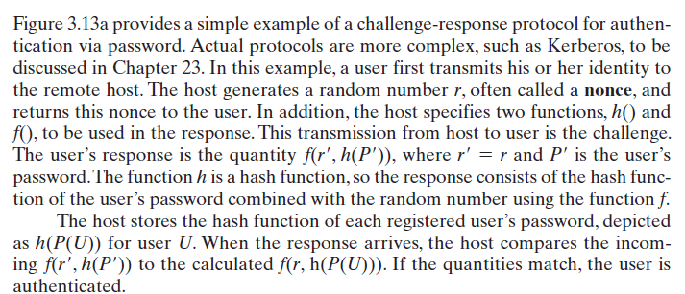
Protocol for a password verification
Similar approach for token and biometric verification (Figure 3.13b,c and d self reading from book)
Notes:
In this example, a user first transmits his or her identity to
the remote host. The host generates a random number r, often called a nonce, and
returns this nonce to the user. In addition, the host specifies two functions, h() and
f(), to be used in the response. This transmission from host to user is the challenge.
The user’s response is the quantity f(r, h(P)), where r = r and P is the user’s
password. The function h is a hash function, so the response consists of the hash function
of the user’s password combined with the random number using the function f.
The host stores the hash function of each registered user’s password, depicted
as h(P(U)) for user U. When the response arrives, the host compares the incoming
f(r, h(P)) to the calculated f(r, h(P(U))). If the quantities match, the user is
authenticated.

Slide 30
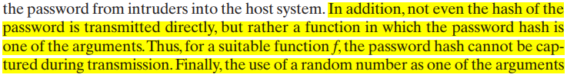

Slide 31
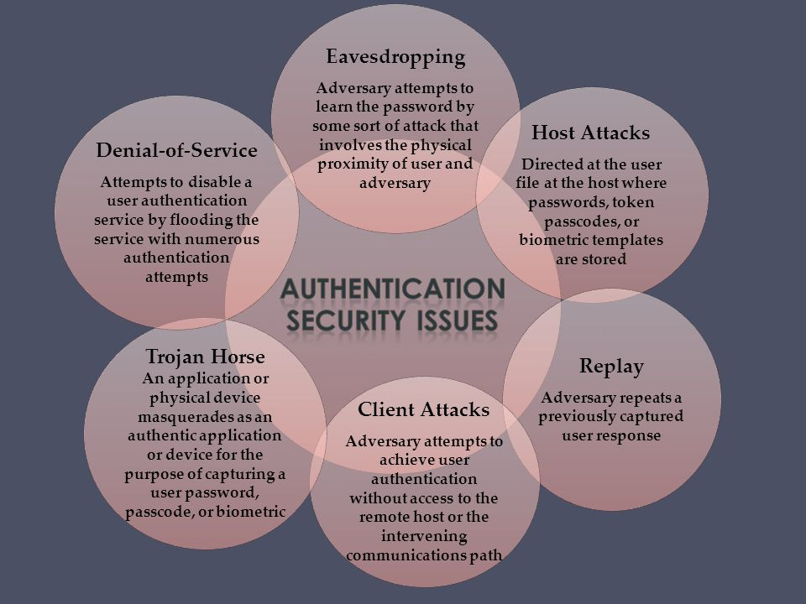
SECURITY ISSUES FOR USER AUTHENTICATION

